Slide 1

Understanding and Using Geometry, Projections and Spatial Reference Systems in ArcGIS
Rob Juergens, Melita Kennedy, Annette Locke

Slide 2
Introduction
We present fundamental concepts necessary for the correct and efficient use of geometry and spatial reference APIs
Geometry types
Spatial references and their properties
How spatial references and geometries interact
Notes:
Purpose
Not to teach you how to code
Our libs low-level with many APIs built on top of them
To give basic understanding of spatial references and geometry

Slide 3
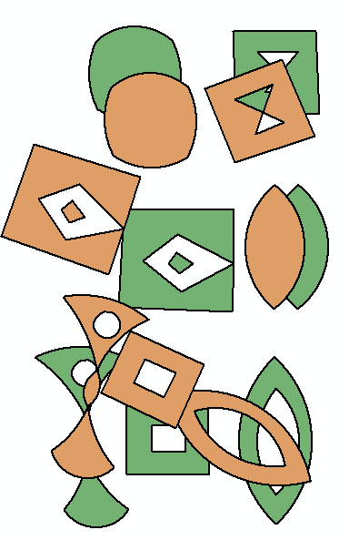
Geometry

Slide 4
What is a geometry?
Defines the shape of a feature
Vector representation for top level types
In other words, vertices have x, y coordinates
Optional z- (height) and m- (measure)

Slide 5
Working with and analyzing geometries
Simple geometry verification
Adhere to a set of rules
Topological operations
For example, Buffer, Symmetric Difference, Union, Intersection
Relational operations
For example, Disjoint, Touches, Overlaps, Crosses, Within

Slide 6
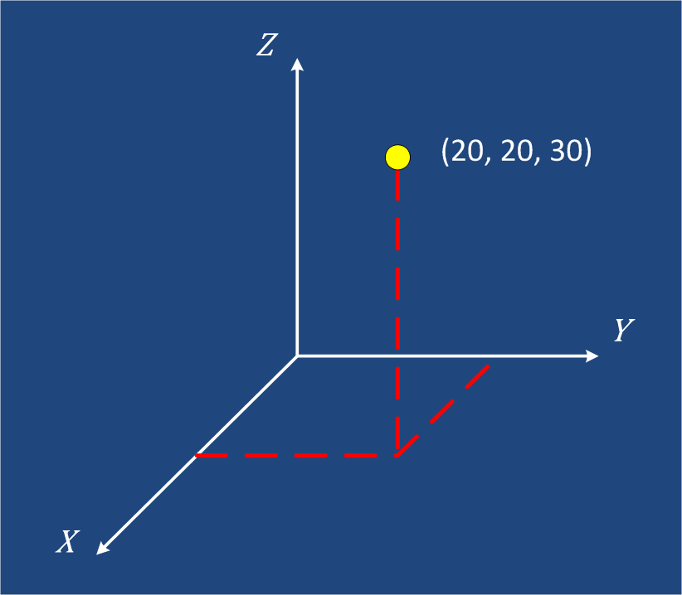
Points
Building blocks for all geometries

Slide 7
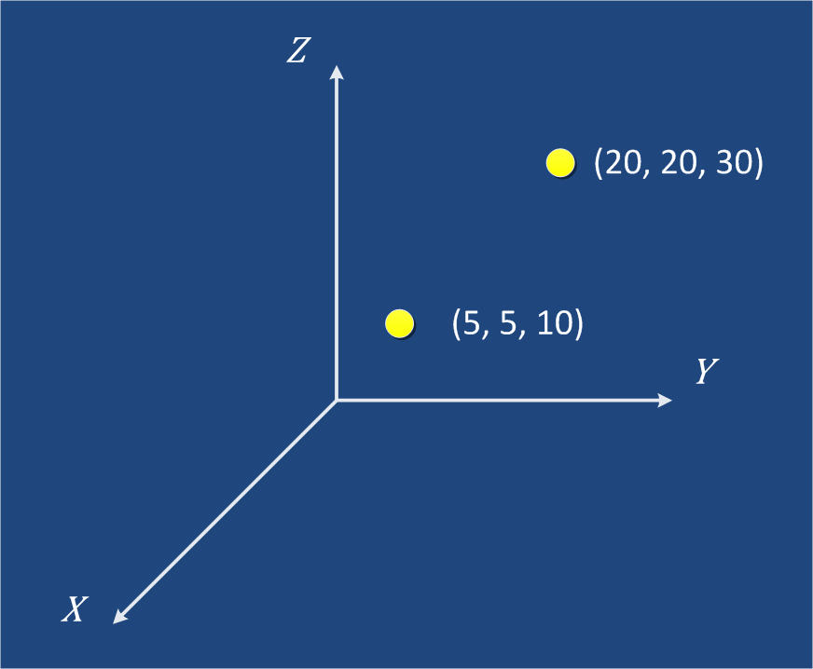
Multipoints
Each multipoint feature is a collection of points

Slide 8
Polylines
A collection of paths
Polyline
Composed of paths
Paths
Composed of segments
Segments
Segments can be four types
Line
Elliptical
Arc
Bézier
Curve
Circular
Arc
Points
Points are used to build segments

Slide 9
Polylines
Single part
Multipart
Notes:
Single part
1 paths, 5 segments
Multipart
2 paths, 4 segments & 3 segments

Slide 10
Polygons
A collection of rings
Polygon
Composed of rings
Rings
Composed of closed segments
Segments
Segments can be four types
Line
Elliptical
Arc
Bézier
Curve
Circular
Arc
Points
Points are used to build segments

Slide 11
Polygons
Outer ring
Inner ring

Slide 12
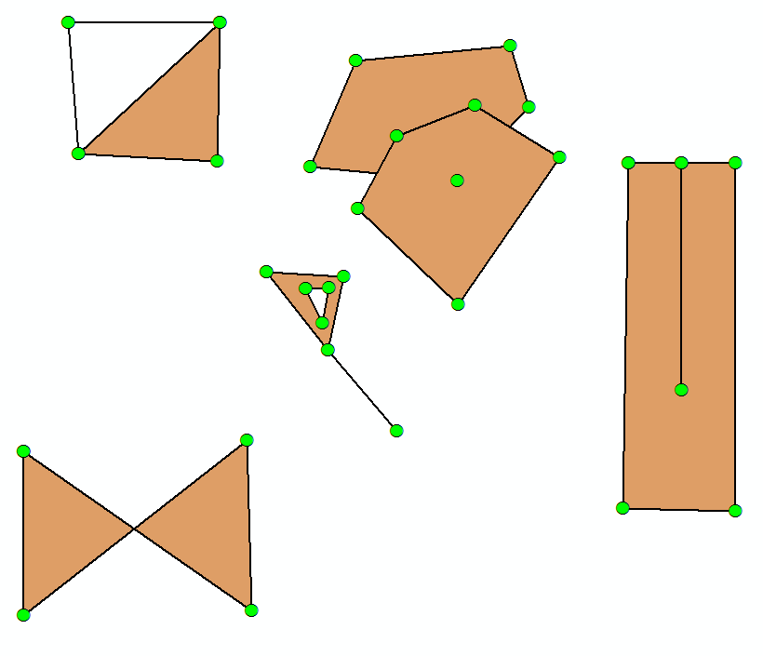
Non-simple Polygons

Slide 13
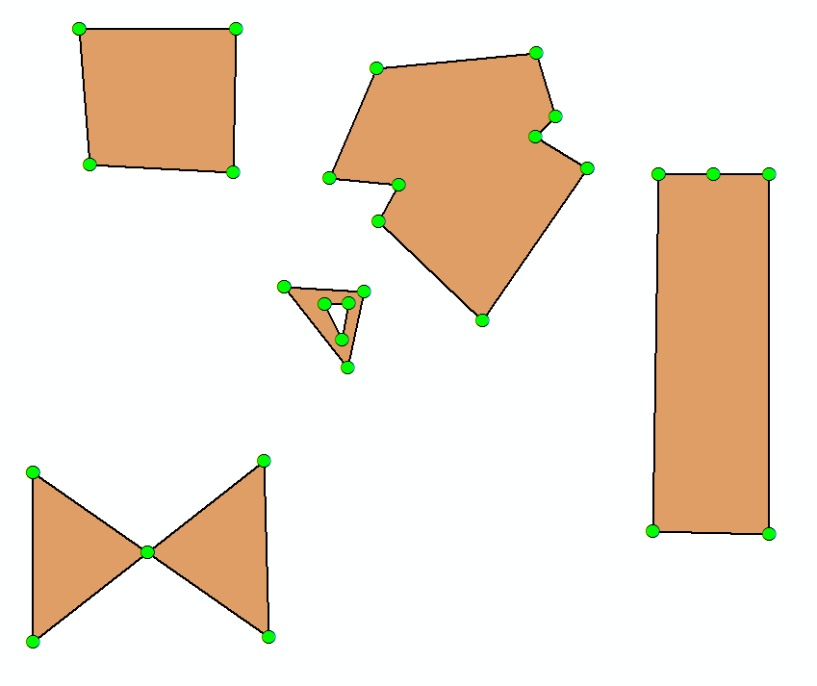
Simple Polygons
Notes:
Simplifying may add or remove vertices.

Slide 14
So what? Why do we care if geometries are simple?
Cannot rely on results from operations using non-simple geometries
Get an error
Get incorrect results

Slide 15
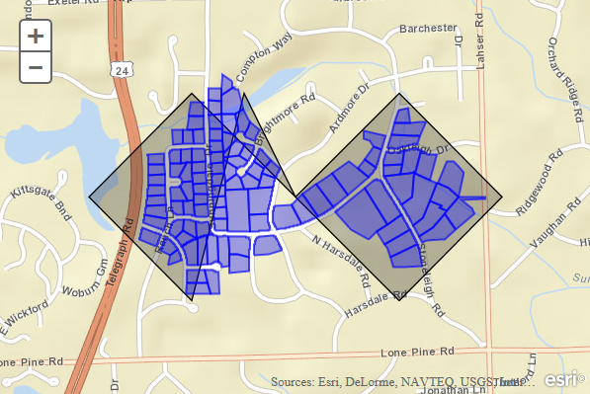
Why do we care if geometries are simple?
Demo
Notes:
Using a Geometry Service back in Redlands
Non-simple polygon, self-intersects
Query parcels contained by polygon
Simplify into a three-part feature then query

Slide 16
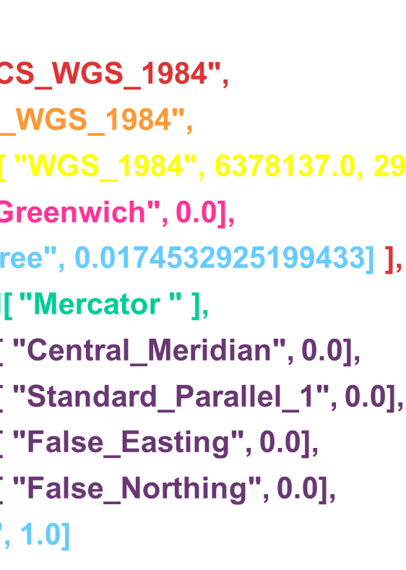
Spatial References

Slide 17
Spatial references
Key properties
Coordinate system
Geographic
Projected
XY Resolution
XY Tolerance
Notes:
The term XY tolerance was introduced in 9.2. Used to be called cluster tolerance.

Slide 18
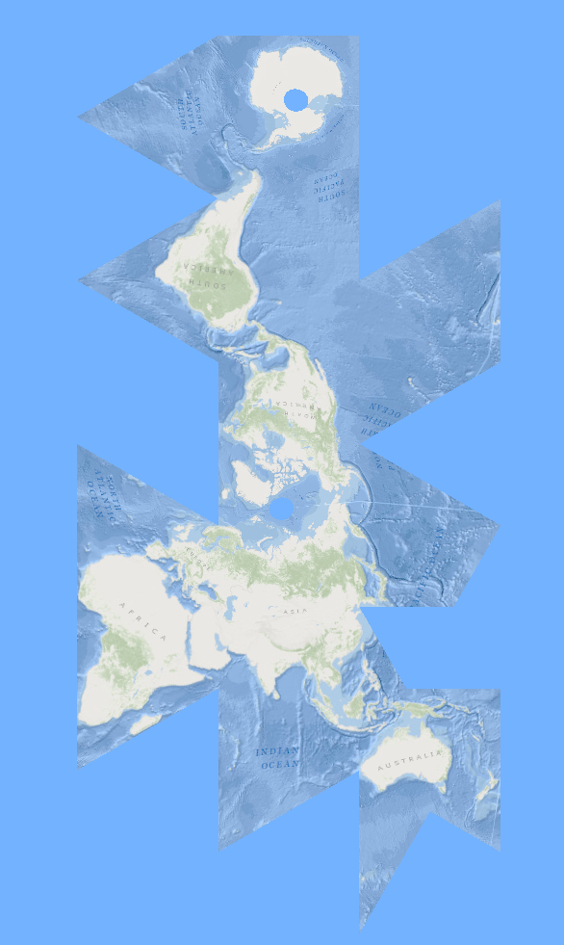
Coordinate systems
Geographic (GCS)
Projected (PCS)

Slide 19
What is a coordinate system?
An agreed upon way to describe locations
Represents locations
Geographic features
Imagery
Observations such as GPS locations
Common geographic framework
Used to integrate geographic locations from different datasets
Notes:
How far is Redlands? I don’t expect the answer in feet from Beijing. I expect it in miles from where I am.
I look at a map, expect North at the top. If I am in Australia, I might expect South to be at the top.
Where we are and who we are talking to determines the way a map is presented. That’s a coordinate system.

Slide 20
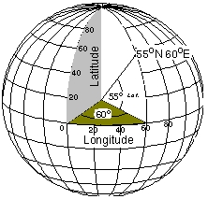
Geographic Coordinate System (GCS)
Global – 3D spherical surface
Point referenced by longitude and latitude values

Slide 21
Projected Coordinate System (PCS)
Flat – 2D surface based on a GCS
Point referenced by x, y coordinates on a grid
Y
X < 0
Y > 0
X > 0
Y > 0
(0,0)
X
X < 0
Y < 0
X > 0
Y < 0

Slide 22
Coordinate System
Projected Coordinate System
Geographic Coordinate System
Projection
Linear Unit
Datum
Prime Meridian
Projection Parameters
Spheroid
Angular Unit
Notes:
Each predefined SR has a coordinate system which can be either projected or geographic.
GCS
coordinates are longitude and latitude
on the spheroid, the globe
Angular units such as degrees or radians
PCS
inherits or contains a geographic coordinate system
Is flat on the map
Linear unit such as feet, meters

Slide 23
Geographic Coordinate System Well-Known Text (WKT)
GEOGCS[ "GCS_WGS_1984",
DATUM[ "D_WGS_1984",
SPHEROID[ "WGS_1984", 6378137.0, 298.257223563] ],
PRIMEM[ "Greenwich", 0.0],
UNIT[ "Degree", 0.0174532925199433] ]
Notes:
Can represent GCS as string.
Datum
spheroid tells you size and shape, WGS_1984
semimajor axis, equatorial axis, of the spheroid.
inverse flattening and tells you how squashed it is versus a sphere.
Does the surface of the spheroid align well with the entire earth like WGS84? Or should it be used in a particular area like NAD27 is used in North America?
Prime meridian - zero position for the longitude values
Unit – how to convert to radians

Slide 24
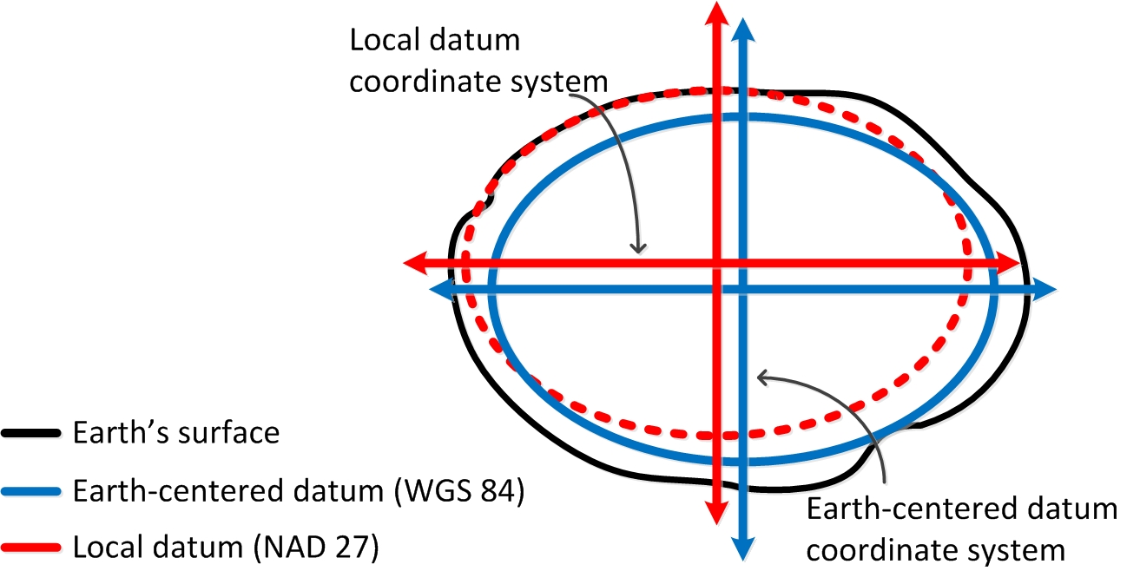
What is a datum?
Notes:
Black is surface of earth
Upper left is North America
local datum fits pretty well in that region
doesn’t fit well in lower right
Earth-centered datum fits relatively well everywhere
Lat/long different on local vs. earth-centered

Slide 25
Projected Coordinate System Well-Known Text (WKT)
PROJCS[ “World_Mercator",
GEOGCS[ "GCS_WGS_1984",
DATUM[ "D_WGS_1984",
SPHEROID[ "WGS_1984", 6378137.0, 298.257223563] ],
PRIMEM[ "Greenwich", 0.0],
UNIT[ "Degree", 0.0174532925199433] ],
PROJECTION[ "Mercator " ],
PARAMETER[ "Central_Meridian", 0.0],
PARAMETER[ "Standard_Parallel_1", 0.0],
PARAMETER[ "False_Easting", 0.0],
PARAMETER[ "False_Northing", 0.0],
UNIT[ “Meter", 1.0] ]
Notes:
PCS
GCS embedded in it.
has a name
a projection—a link to the mathematical algorithm
parameters that the projection needs
linear unit – how to convert to meters

Slide 26
Well-Known ID (WKID)
Every predefined coordinate system has a WKID
For example, GCS_WGS_1984, WKID = 4326
WKID < 32767 is EPSG assigned
EPSG Geodetic Parameter Dataset, http://www.epsg-registry.org/
WKID > 32767 is Esri assigned
Esri WKID may change
Esri → EPSG
Old WKID will still work
Example, Web Mercator 102100 → 3857
Notes:
Each projection engine object, such as a coordinate system, unit, or spheroid has a well-known id
You may also hear “EPSG code”. The EPSG Geodetic Parameter Dataset contains lists of coordinate systems and transformations and the objects that make them up.

Slide 27
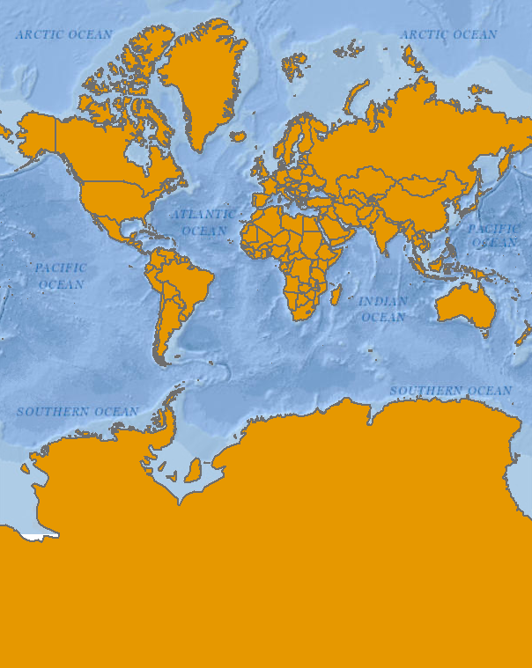
All projections have some distortion
Web Mercator Projection
Notes:
Mercator projection distorts area and distance
See the distortion of Antarctica
South America is actually 7 times bigger than Greenland

Slide 28
What is happening when we project data?
Case 1: Both PCSs contain the same GCS
PCS A1
PCS A2
(x, y)
Projection
Projection
GCS A
(lon, lat)
(λ, φ)
Notes:
What really happens when you project data?
Converting from PCS A1, which is using GCS A to PCS A2, also based on A
Direct projection that takes two steps
Unproject from A1 to A
Project from A to A2.

Slide 29
What is happening when we project data?
Case 2: Each PCS contains a different GCS
PCS A1
PCS B1
(x, y)
Projection
Projection
GCS A
GCS B
(lon, lat)
Geographic Transformation
(λ, φ)
Notes:
Output projected coordinate system is B1, based on GCS B.
The 1st step is still to unproject to A.
Then convert latitude and longitude values from GCS A to GCS B. That requires a geographic, or datum, transformation.
Once that’s done, we project from GCS B to PCS B1.

Slide 30
Geographic Transformations (GT)
Convert from one GCS to another GCS
Suitable for a particular area
Defined in a particular direction
For example, NAD27 to WGS84
All are reversible
May be more than one applicable GT
Notes:
A geographic transformation converts between two geographic coordinate systems.
Lat/long on one ellipsoid may be different on another.
All transformation methods convert everything that might need to be changed, including the units, prime meridian, and the spheroid.
Each transformation is always defined in a particular direction, from “A” to “B”, but are completely reversible. In
ArcMap, we present a list in order of most to least suitable. Normally, you want to use the top entry

Slide 31
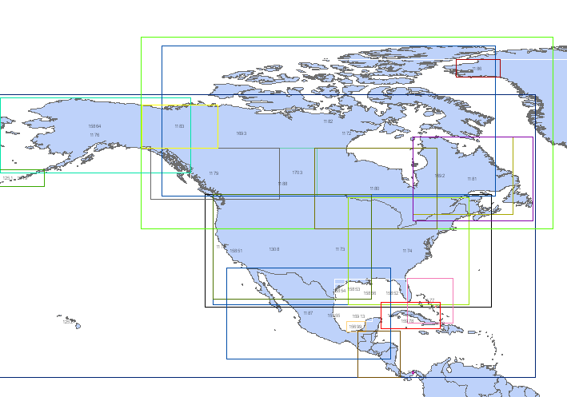
There are 38 transformations between GCS_North_American_1927 and GCS_WGS_1984
Which is best?
Depends on the region covered by your data
Notes:
Which is best?
Depends on the region covered by your data

Slide 32
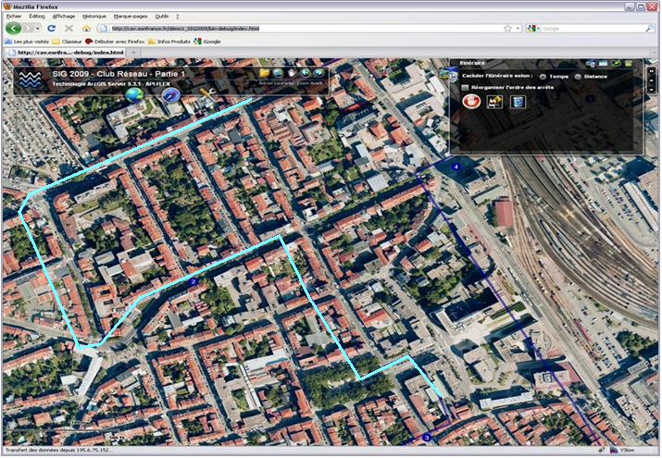
Why do we need to transform our data?
European Datum 1950 vs. World Geodetic System 1984
Notes:
Vector and raster layers
ED50 (European Datum 1950) and WGS84 (World Geodetic System 1984)
Red ellipse – lines up OK
Yellow ellipse – not OK
To fix, transform one of the layers

Slide 33
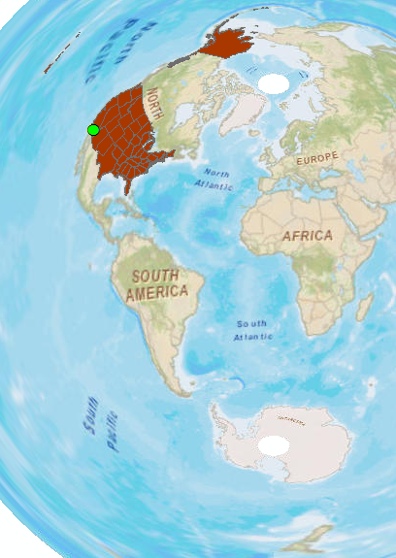
Projection between different GCSs
Demo
Notes:
Map of US States and Palm Springs with Oceans base map.
Data frame is NAD 83 UTM Zone 5. Add States doesn’t look good.
Change to NAD 83 UTM Zone 14. Same GCS so no transformation.
Now change to Fuller. GCS is WGS 84. ArcMap will ask for transformation. Pick the first one.
Change to Azimuthal Equidistant. Same GCS.

Slide 34
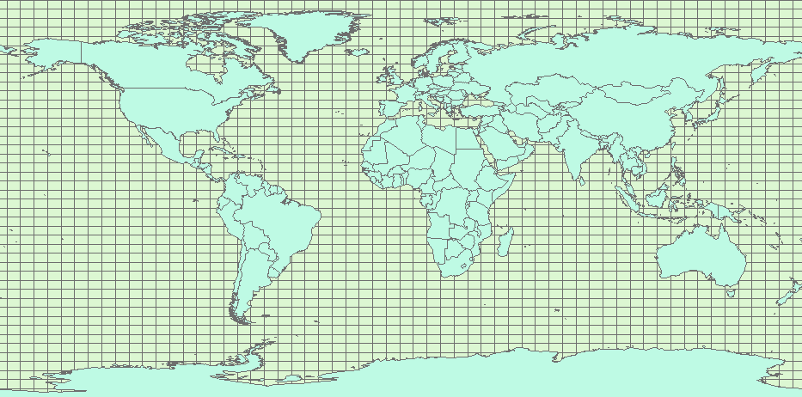
Resolution and Tolerance

Slide 35
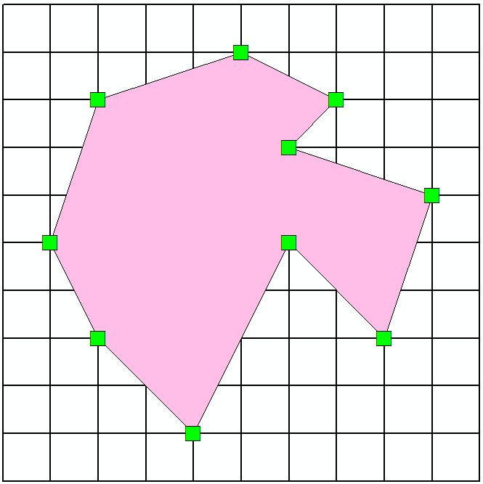
XY Resolution
Numeric precision used to store x, y coordinate values
All coordinates lie on coordinate grid
Default value is 0.0001 meters or equivalent
x₁ = 5.1234, x₂ = 5.1235 stored as unique coordinate values
x₁ = 5.12344, x₂ = 5.12345 both stored as 5.1234
Each square in grid is 0.0001 x 0.0001
Notes:
If |x1 – x2| <= res, then stored as same number
Default value in meters. 1/10 millimeter
If SR has feet, then default is 0.0001 m = 0.0003281 ft
Lat/long then 0.000000001 degrees
If developing own app, you have to set xy-resolution probably.

Slide 36
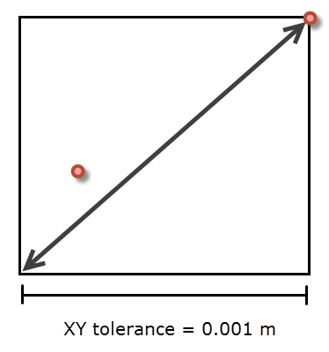
XY Tolerance
Minimum distance between coordinates when processing features
Simple geometry validation
Topological operations such as Buffer
Relational operations
Editing operations
Notes:
Tolerance comes into play when processing features, not storing them.

Slide 37
XY Tolerance

Slide 38
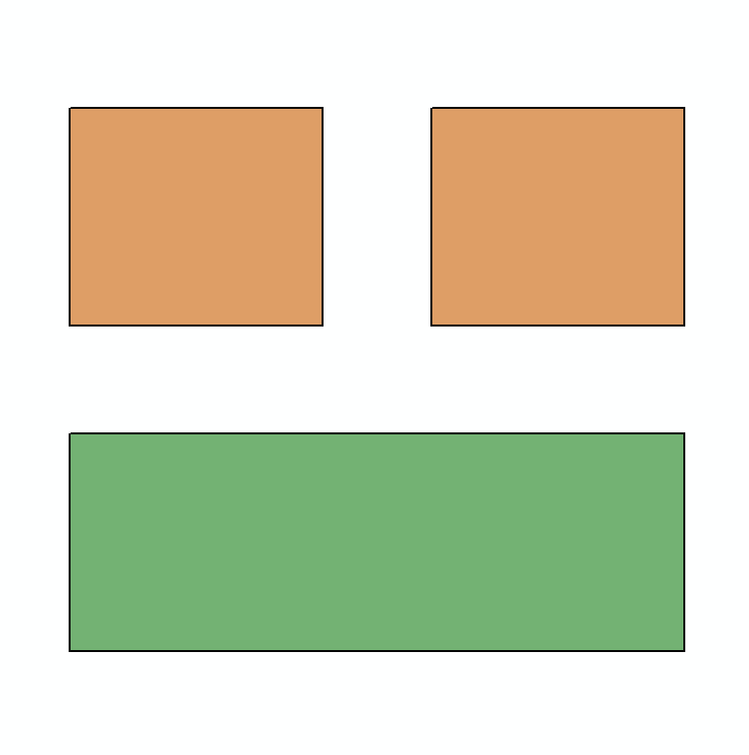
Merge polygons
Demo

Slide 39
Resolution vs. Tolerance
Resolution: refers to number of decimal places used to store x, y coordinate values
Tolerance: minimum separation between features used by some operations
Should never be less than 10 times resolution
Default resolution = 0.0001 meter or equivalent
Default tolerance = 0.001 meter or equivalent
Highly recommended to use default values!
Notes:
Storage vs. processing

Slide 40
What do spatial references have to do with geometries?
Geometry is a collection of points
Spatial reference determines
where the coordinates are placed
how the coordinates interact with each other

Slide 41
How does a spatial reference affect a geometry?
We need to know where to put the geometry on the map
A geometry that is simple in one spatial reference may not be so in another spatial reference
Remember, garbage in, garbage out
An operation on features may give different results depending on the spatial reference

Slide 42
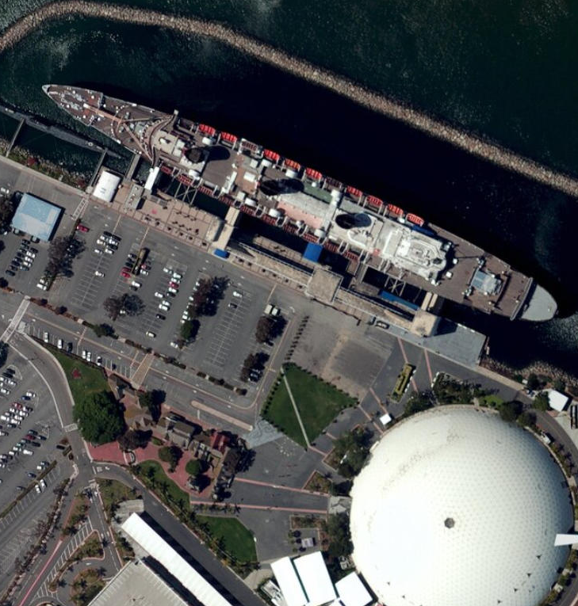
Where on the map do I put the geometry?
Demo

Slide 43
How does a spatial reference affect a geometry?
We need to know where to put the geometry on the map
A geometry that is simple in one spatial reference may not be so in another spatial reference
Remember, garbage in, garbage out
An operation on features may give different results depending on the spatial reference

Slide 44
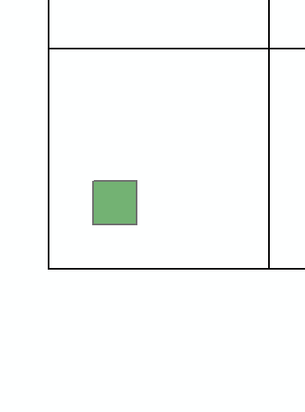
What is simple here may not be simple there
Demo
Notes:
This rectangle lives inside one square of tolerance. All 4 vertices are considered the same when checking validity.

Slide 45
How does a spatial reference affect a geometry?
We need to know where to put the geometry on the map
A geometry that is simple in one spatial reference may not be so in another spatial reference
Remember, garbage in, garbage out
An operation on features may give different results depending on the spatial reference

Slide 46
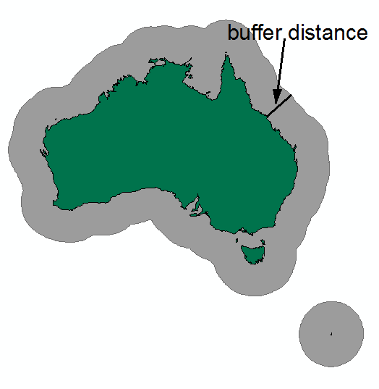
An operation on features may give different results depending on the spatial reference
For example, Buffer operation
Notes:
Buffer operation
creates a new geometry such that each point is a given distance from the original geometry.
Euclidean distance – flat map projection
Geodesic distance – shortest path on surface of the earth

Slide 47
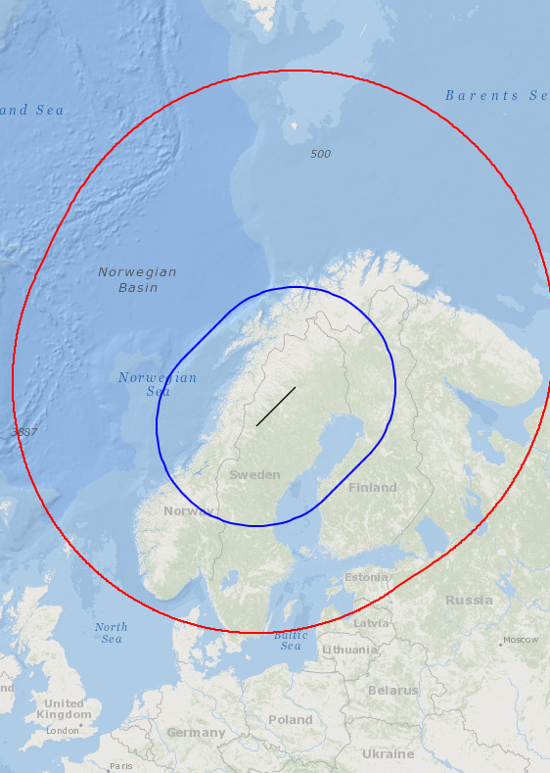
Buffer and Spatial Reference
Demo
Web Mercator Buffer Demo
Azimuthal Equidistant Buffer Demo
Notes:
Red is geodesic buffer, blue is planar buffer
Change where we calculate the buffer

Slide 48
References
http://resources.arcgis.com/en/help
Desktop → Guide Books → Map projections
Developer Help
List of ArcGIS APIs
Lining Up Data in ArcGIS, Margaret Maher
ESRI Technical paper: Understanding Coordinate Management in the Geodatabase
ESRI Technical paper: Understanding Geometric Processing in ArcGIS

Slide 49
Resources
Links for demos, data and more!
ArcMap Demos
Projection between different GCSs
Merge polygons
Where on the map do I put the geometry?
What is simple here may not be simple there
JavaScript Demos
Why do we care if geometries are simple?
Buffer and Spatial Reference
Web Mercator
Azimuthal Equidistant
Python Toolbox to convert JSON to GDB

Slide 50
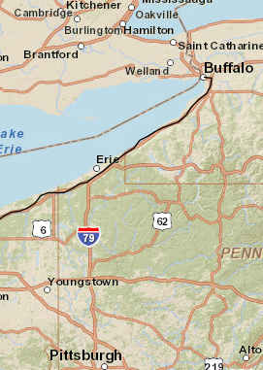
That’s all folks! Don’t forget to fill out the survey Understanding and Using Geometry, Projections and Spatial Reference Systems in ArcGIS

